Slide 1

Some transfer ideas during LS2 and beyond
David Sharp,
The University of Manchester
ISS workshop, July 13th 2017
Notes:
1

Slide 2
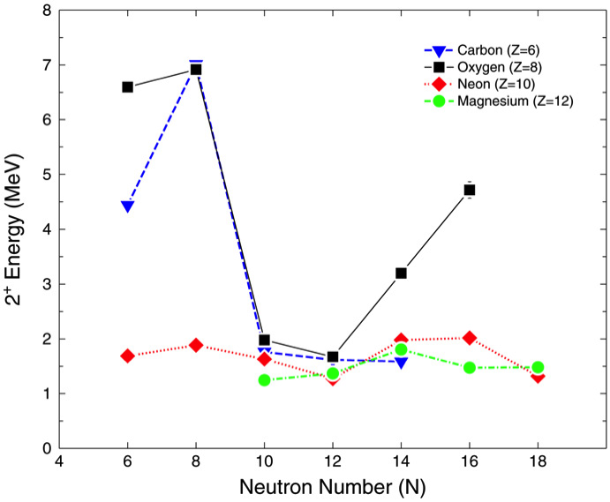
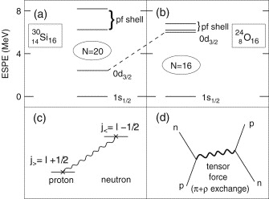
Evolution of single-particle structure
Study of the evolution of single-particle structure in light neutron-rich systems has led to discoveries of dramatic changes leading to the weakening and appearance of shell closures.
Such changes can be interpreted as arising from effects of the valence nucleon interactions, where increasing occupation of a particular valence proton orbital will have a larger interaction on valence neutrons, for example.
C. Hoffman et al, Phys. Lett. B 672 17 (2009)
D. Steppenbeck et al, Nature 502 207 (2013)
T.Otsuke and D. Abe Prog. In Particle and Nuclear Physics 59 425 (2007)

Slide 3
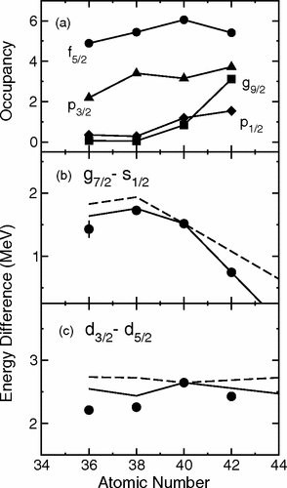
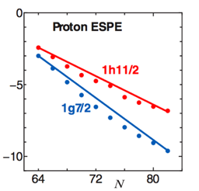
Evolution of single-particle structure
Similarly trends have even been observed in stable heavier nuclei.
Studies of chains of isotopes/isotones have pointed to fairly robust mechanisms for these changes such as the requirement to include a tensor interaction (N=51, Z=51, N=83).
Access to RIBs at HIE-ISOLDE will allow access to measurements across large chains of isotopes/isotones probing the interactions further from stability.
πh_{11/2}
νh_{11/2}
πg_{7/2}
proton
neutron
Otsuka et al. Phys. Rev. Lett. 95, 232502 (2005)
D.K. Sharp et al, Phys.Rev.C 87 014312 (2013)

Slide 4
N=83 isotones
Stable N=82 targets have been used to investigate trends in high-j single-particle strengths.
The behaviour of the deduced centroids is consistent with the effects of the tensor interaction.
Fragmentation of the h_{11/2} and i_{13/2} states is quite high due to extensive coupling with quadrupole and octupole vibrational states in the core, so measured spectroscopic factors are essential to disentangle the resulting energy centroids.
At Z=64 the particle-core coupling to the vibrational states is expected to be strongest.
B. P. Kay et al, Phys.Lett.B 658 216 (2008)
B. P. Kay et al, Phys.Rev.C 84 024325 (2011)

Slide 5
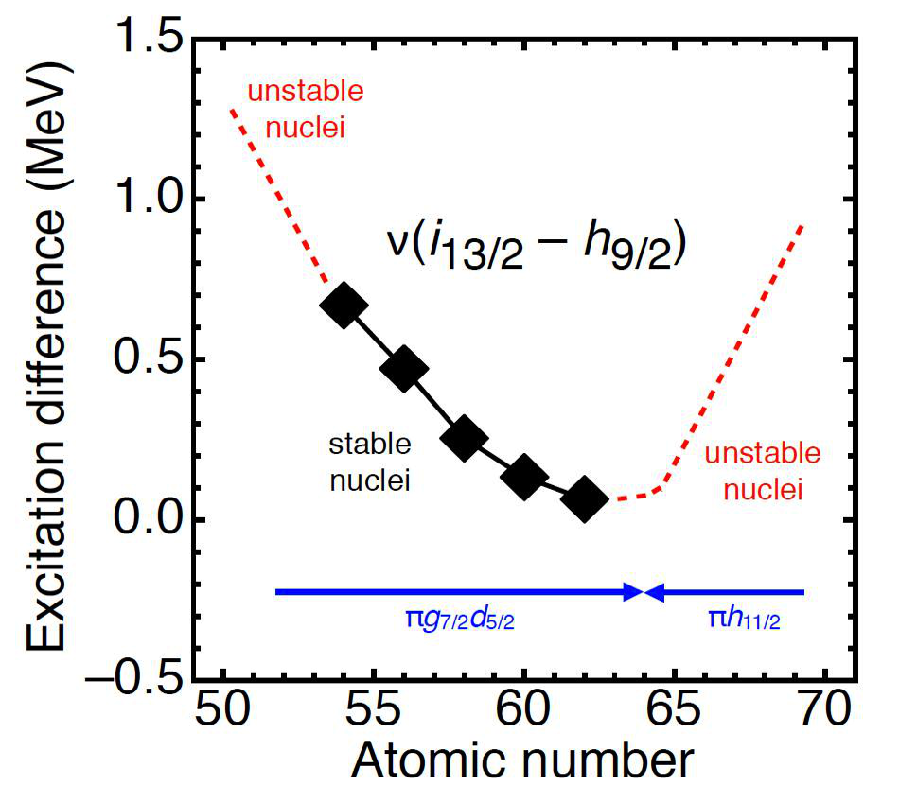
N=83 isotones
Away from stability the proton Fermi surface moves from filling predominantly the g_{7/2} to the h_{11/2}. As such the sense of the tensor interaction reverses which should cause the difference in the energies to increase again.
Measurements of neutron-adding reactions using N=82 beams will allow an investigation of this behaviour. What effect does the particle-core coupling play? Need to carefully consider fragmentation.
Rates from yield database assuming 10% transmission to ISS:
¹⁴⁶Gd(Z=64) 10⁷ pps
¹⁴⁸Dy (Z=66) 10⁵⁻⁷ pps
¹⁵⁰Er (Z=68) 10⁵ pps
B. P. Kay et al, Phys.Lett.B 658 216 (2008)
B. P. Kay et al, Phys.Rev.C 84 024325 (2011)

Slide 6
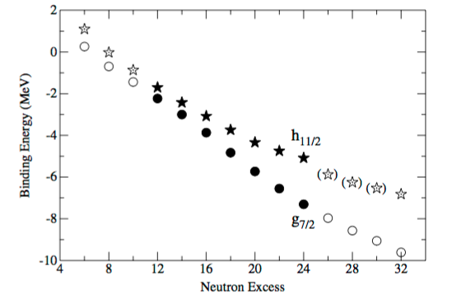
Sn isotones
Previous measurement of proton-adding reaction using stable targets investigated evolution of high-j single-particle strength.
Robust measurements of neutron-adding and -removing reactions of even stable Sn isotopes have been recently made, probing neutron single-particle energies and occupancies.
Opportunity to expand these measurements at HIE-ISOLDE allowing a study of the evolution of neutron and proton single-states from ¹⁰⁶⁻¹³⁴Sn – 28 neutrons.
Would require a gas cell in the future to make (a,t) or (³He,d) measurements to populate proton states.
¹⁰⁶⁻¹¹⁰Sn and ¹²⁸⁻¹³⁴Sn >10⁵ pps.
¹²⁶Sn long-lived beam.
Protons - J. P. Schiffer et al., Phys. Rev. Lett. 92, 162501 (2004)
Neutrons - D.K. Sharp et al, In preparation

Slide 7
¹²⁶Sn(d,p) – Evolution along Z=50
The (d,p) reaction will be used to probe the vacancy of the orbitals in ¹²⁶Sn as well as confirming the location of the low-lying single-particle states in ¹²⁷Sn.
Outside stable targets (d,p) measurements have previously been made on ^{130,132}Sn.
These data will help complete the picture of the evolution of these single-particle orbitals away from the stable tins towards the shell closure at ¹³²Sn. Expanding on a systematic study of the stable Sn.
The case of ¹²⁶Sn (T_{1/2} = 2.3E5 years) is directly produced when protons are incident on Ucx targets and is volatile enough to be released from a hot target and so may require the irradiation of a cold target to maximise the yield.

Slide 8
Single-particle evolution along N=126
N=126 isotones and Pb isotopes provide further testing grounds for evolving shell-structure and modern shell-model calculations.
(d,p) reaction probes single-neutron states in N=127 nuclei. Along N=127 there is little data which is directly sensitive to the single-particle behaviour. Some data exists on ²¹¹Po but there are missing assignments.
Measurements of these states in nuclei up to Z=88 are feasible at HIE-ISOLDE with ISS.
²¹⁰Po (Z=84) long-lived beam.
²¹²Rn (Z=86) 10⁷ pps.
²¹⁴Ra (Z=88) 10⁵ pps.

Slide 9
²¹⁰Po(d,p) – Single-particle evolution along N=126
Measurements of single-neutron properties of ²¹¹Po using a long lived ²¹⁰Po beam is the first step in probing along this isotonic chain north of ²⁰⁸Pb.
²¹⁰Po (T_{1/2}=138 days) is directly produced when protons are incident on Ucx targets and is volatile enough to be released from a hot target. Irradiation of a cold target unit may be required to maximise the ²¹⁰Po yield.
(d,p) reaction will be best suited to studying low-l states in the residual nucleus, though it will also populate higher-l orbitals.

Slide 10
²¹⁰Pb(d,p) – Single-particle states near N=126, Z=82
Nuclei near doubly-magic shell closures provide good testing grounds for shell-model calculations.
²¹⁰Pb is only two neutrons from the doubly-magic shell closure at Z = 82 and N = 126.
Neutron-adding on this nucleus will probe the 1g_{9/2}, 0i_{11/2}, 0j_{15/2}, 2d_{5/2}, 3s_{1/2}, 1g_{7/2} and 2d_{3/2} single-particle strength in ²¹¹Pb to varying degrees. The reaction is best suited to the study of the 2d and 3s_{1/2} states, but will also locate the higher-j strength.
These data will act as a test of modern shell model calculations and can be used to predict the evolution of single-particle structure further from doubly-magic ²⁰⁸Pb.
Some previous (t,d) data exist, however, the measured angular distributions were somewhat featureless and therefore assignments are not necessarily reliable.
In the decay chain of ²²⁸Th (T_{1/2} = 1.9 years), there is a waiting point at ²¹⁰Pb (T_{1/2} = 22.2 years), which will have built up in UCx targets irradiated in the past. RILIS will be used to extract ²¹⁰Pb beams from previously irradiated UCx targets. i.e. no new target irradiation required.

Slide 11
Single-particle evolution along Z=82
Very little single-particle information in neutron deficient Pb isotopes.
Opportunity to study single-particle evolution over a large change in neutron excess. Lead beams covering a difference of 22 neutrons are feasible in terms of rates.
¹⁸⁸⁻²⁰²Pb (N=106-120) 10^5-6 pps
²¹⁰Pb (N=128) long-lived beam
How does single-particle behaviour influence changes in structure in this region?

Slide 12
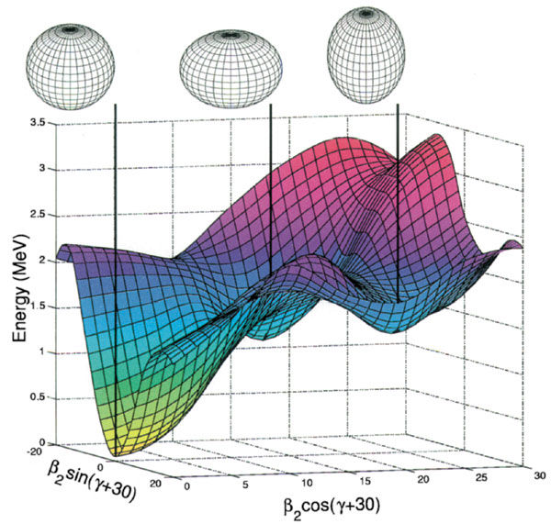
Single-particle evolution along Z=82
Shape coexistence in this region described by 2p-2h and 4p-4h excitations above N=82.
How do proton-neutron interactions influence the onset of shape-coexistence in the Pb region?
Use (d,p) reactions to probe single-particle energies and occupancies in neutron deficient Pb nuclei. Also Hg…...
13/2+ states may be of particular interest due to large overlap with protons populating h_{9/2} above N=82. Populated weakly in (d,p) though. Resolution limitations…

Slide 13
Summary
HIE-ISOLDE+ISS provide opportunities to extend studies of the evolution of single-particle behaviour to more exotic regions of the nuclear chart along long chains of isotopes and isotones.
Several potential cases for measurements for after LS2 (N=82, Sn, Pb…).
During LS2 first of these measurements can potentially be made with long-lived beams from old targets or cold irradiated targets.....LOI submitted.

