Slide 1
Simone Ceruti
KU Leuven, Instituut voor Kern- en
Stralingsfysica
Study of
Pygmy Dipole States with an Active Target

Slide 2
Outline
Physics Case: Pygmy states
Motivation: beyond nuclear physics
SpecMAT
Conclusions

Slide 3
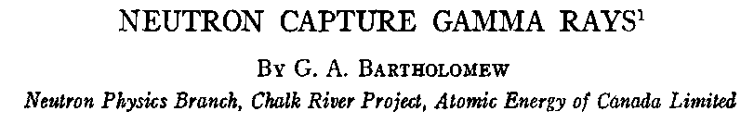
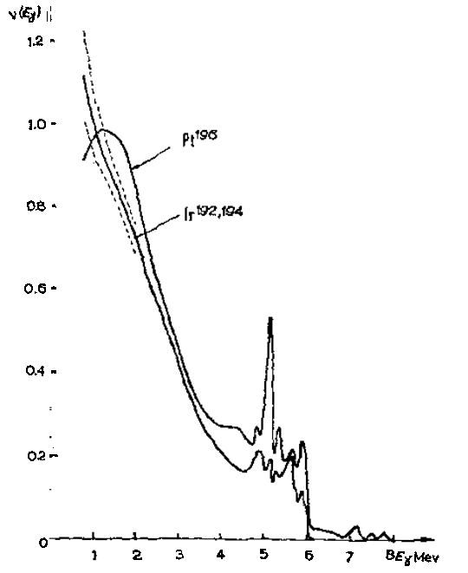
Physics Case
Evidence of low-energy electric dipole strength around neutron separation energy
The story started many years ago
First observation in 1961
“These spectra provide examples of an unusual predominance of high-energy radiation”

Slide 4
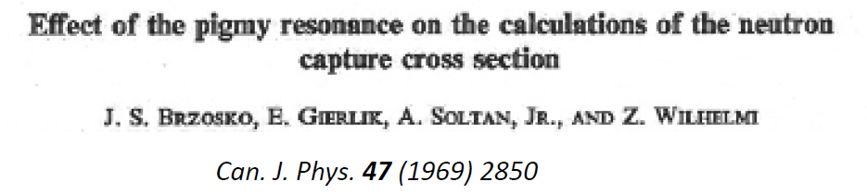
Physics Case
Evidence of low-energy electric dipole strength around neutron separation energy
The story started many years ago..
First observation in 1961
In 1969 the term “pygmy resonance” was used for the first time
Study of the influence of these unusual states on the neutron capture cross section.

Slide 5
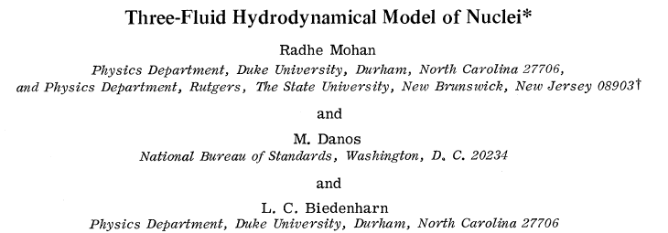
Physics Case
Evidence of low-energy electric dipole strength around neutron separation energy
The story started many years ago..
First observation in 1961
In 1969 the term “pygmy resonance” was used for the first time
In 1971 collective description of this strength
Neutron excess oscillates against the N=Z core

Slide 6
Physics Case
Conclusion: E1 response has two main contributions:
    GDR (well know Giant Resonance)
    PDR (unknown E1 strength)
theory
experiment
GDR
PDR
A. Carbone, PRC 81 (2010)
D. Savran et al., Progress in Particle and Nuclear Physics 70 (2013)

Slide 7
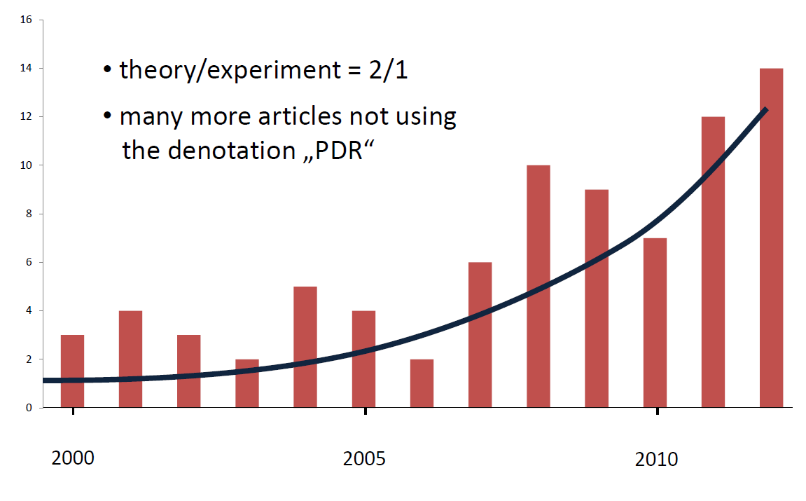
Physics Case
Conclusion: E1 response has two main contributions:
    GDR (well know Giant Resonance)
    PDR (unknown E1 strength) → Expected to increase with N/Z
Taken from
A. Zilges
Large interest in recent years
Less experimental works than theoretical

Slide 8
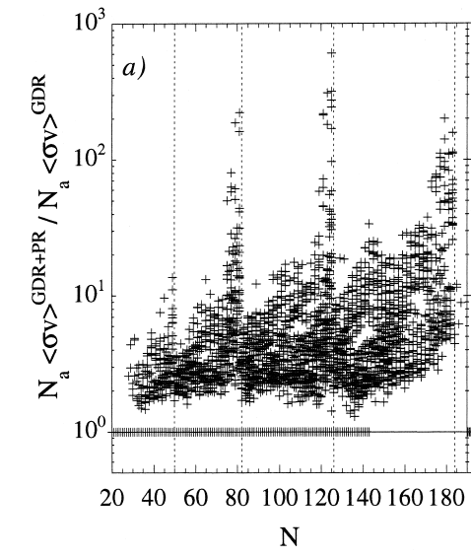
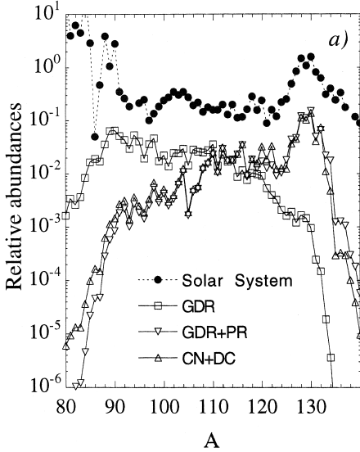
Motivation
Astrophysics interest → r-process mechanism
Neutron capture mechanism is influenced by the presence of GDR tail
Presence of additional strength increases the (n,γ) rate
Impact on the abundance distribution
Goriely, PLB 436 (1998)
1% strength means an increase of a factor 5 the (n,γ) cross section

Slide 9
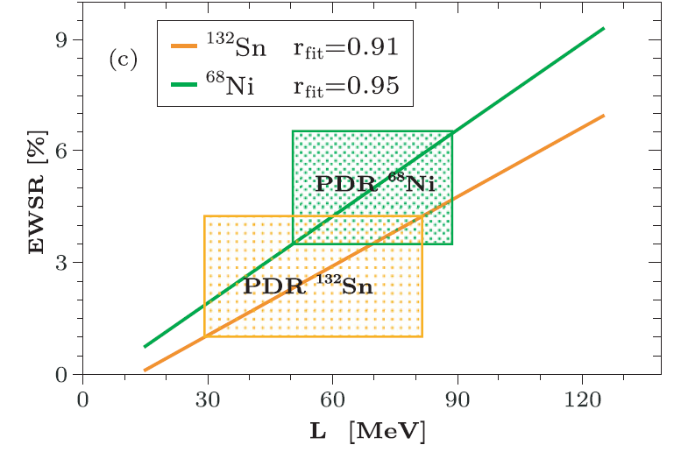
Motivation
Nuclear Structure interest→ Is it a Collective state as the GDR?
Oscillation of the neutron excess against the core.
Connection with neutron skin and Equation of State (neutron star)
Strength of the
Pygmy
Ingredient of EoS
Symmetry Energy slope
A. Carbone, PRC 81 (2010)

Slide 10
Motivation
How can we excite these states?
Real photon (γ,γ’)
Coulomb excitation
Hadron probe (p,p’), (α,α’), (17Ο, 17Ο’)
Different probes to investigate
the nature of these states
IsoScalar probe
neutron-skin
Evidence
+
Interpreted theoretically as:
IsoVector probe
Transitional region to
GDR Tail
J. Endres, PRL 105 (2010)

Slide 11
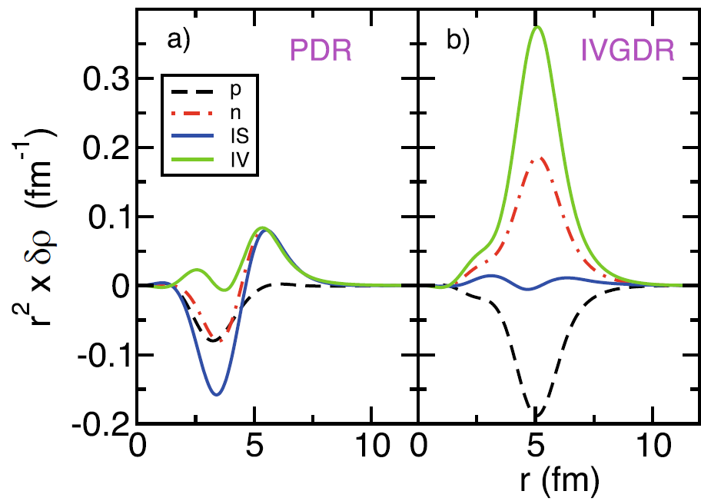
Motivation
How can we excite these states?
Real photon (γ,γ’)
Coulomb excitation
Hadron probe (p,p’), (α,α’), (17Ο, 17Ο’)
Different probes to investigate
the nature of these states
Transition density, RPA calculation
neutron-skin signature??
Other experimental data are needed!
Bracco et al., EPJA 51, (2015)

Slide 12
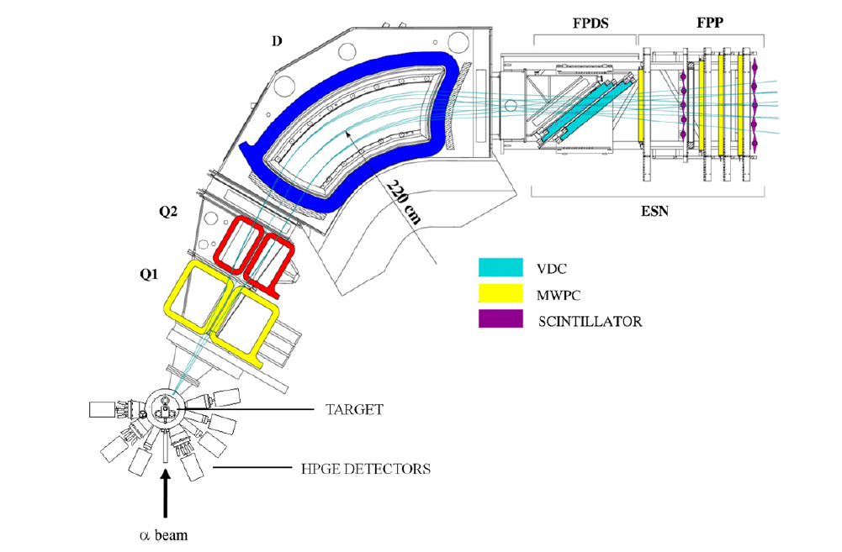
SpecMAT
Isoscalar probe→ alpha beam
Stable nuclei → Direct Kinematic
Low sensitivity to multipolarity of hadron scattering
Detection of gamma rays to select the mulipolarity
Analysis based on γ−X angular correlation
Selection E1 states
KVI
α scattering

Slide 13
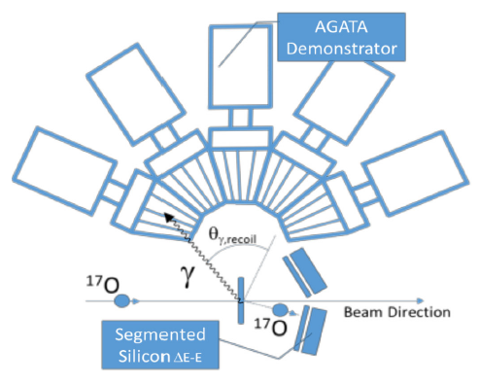
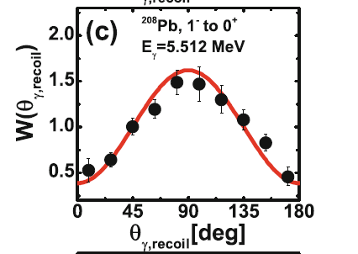
SpecMAT
Isoscalar probe→ alpha beam
Stable nuclei → Direct Kinematic
Low sensitivity to multipolarity of hadron scattering
Detection of gamma rays to select the mulipolarity
Analysis based on γ−X angular correlation
Selection E1 states
LNL-Milano group
17Ο scattering

Slide 14
SpecMAT
In exotic nuclei→ Inverse Kinematic
The effect is expected to be larger
Solid Target→13C or He-implanted foil
Cross section is maximum at forward c.m. angle
90Sr+α @ 10 MeV/u
θ_{cm}=6
θ_{cm}=2
θ_{cm}=4
θ_{cm}=0
Not enough energy to escape a solid target
Particle information is missing

Slide 15
SpecMAT
SpecMAT
  gamma and particle detection
  Reconstruction of the kinematics → Interaction point
                → Particle energy (Q-value reconstruction)
                → Particle direction (angular distribution)
  Selection of ground-state transitions
  Identification of E1 transition from γ angular distribution
  Use of α gas

Slide 16
SpecMAT
Particle Detection
  Energy resolution depends on the length of the track
  Higher pressure → Higher cross section → Shorter track → Lower resolution
  Compromise is needed
  Tuning of the magnetic field intensity
  Limit on beam intensity 10⁶ pps

Slide 17
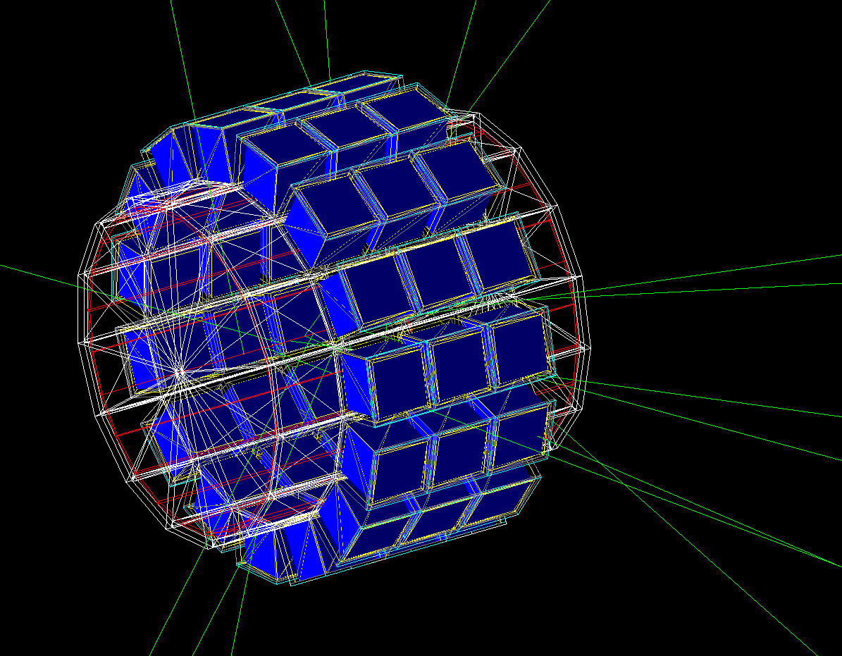
SpecMAT
Gamma detection
  Energy Resolution is not crucial
  Efficiency is crucial (Add-back)
  Doppler correction
  Good Angular Coverage→ Multipolarity selection

Slide 18
Conclusions
Submitted a LoI at ISOLDE to study isoscalar E1 strength
Long-living/stable nuclei (⁹⁰Sr,^{150, 148, 156}Gd, ¹⁹⁴Hg)
Still open questions
The study of neutron-rich system can help
SpecMAT could be a valid experimental option

Slide 19
Thanks for your attention
Notes:
During my brief career I had the possibility to explore two different aspects of nuclear structure. One is the collective behaviour of nuclei and the other one is the single-particle mechanisms. Indeed in the nucleus can be modelized in two ways. One is considering the nucleons as independent particles and using an approach common to atomic physics: the shell model. This reproduces many properties of nuclei but not all the observable, because the nucleus exhibit also collective characterstics as vibration and rotation mechanism where the nucleus where the nucleus as a whole is involved.

Slide 20
Equation of state

