Slide 1
Inelastic scattering with ISS
Peter Butler (U. Liverpool)
(dσ/dΩ)_{l} ^{exp} = β_{l} ²(dσ/dΩ)_{l} ^{DWBA}
B(El;0 → l) = (3ZeR_{l}/4π)²β_{l} ²
H.I. Coulex (d,d’)
B(Eλ) mostly isoscalar isoscalar (systematic difference)
purely EM strong+Coulomb (sys. error but higher σ)
single channel competing channels (possible backgrd.)
multi-step (H.I.) ~single-step (simpler analysis)
transitions states (simpler analysis, see g.s.)
particle-gamma particle (no icc problems, higher ε)
thick target thin target (σ x ε x t ~ Coulex p-γ)
10-15 keV > 20 keV

Slide 2
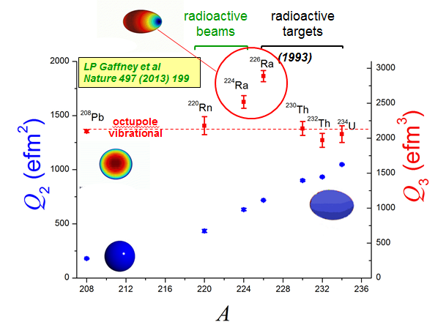
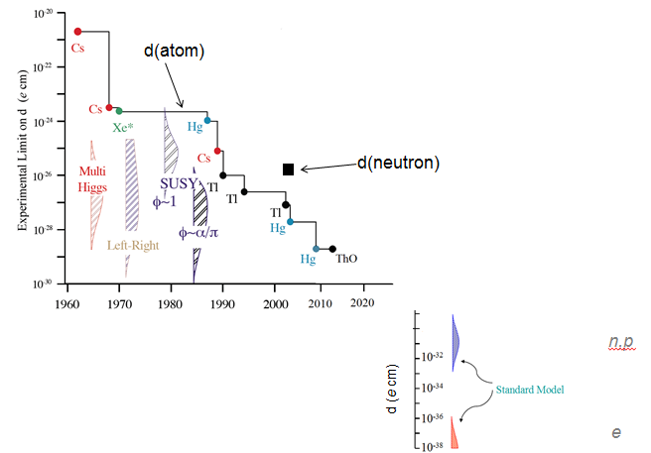
Motivation #1: Octupole enhanced atomic EDM moment
related to Q₃
P,T-violating n-n interaction,etc
Schiff moment:
energy splitting of parity doublet
Measured in ²²⁰Rn, ^{224,226}Ra
(but not odd-A nuclei)
Measured in ^{223,225}Ra
(but not odd-A Rn)

Slide 3
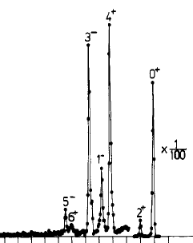
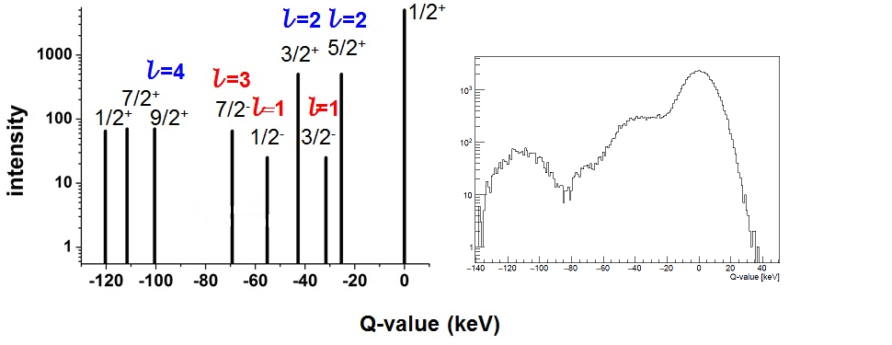
expected spectrum for ²²⁵Ra
²²⁶Ra(d,d’)
actual data
Thorsteinsen et al.
Phys. Scr. 42 (1990) 141
ΔE ~ 10 keV
-400 -200 0
²²⁵Ra(d,d’)
courtesy L Gaffney
ΔE (FWHM) = 20 keV

Slide 4
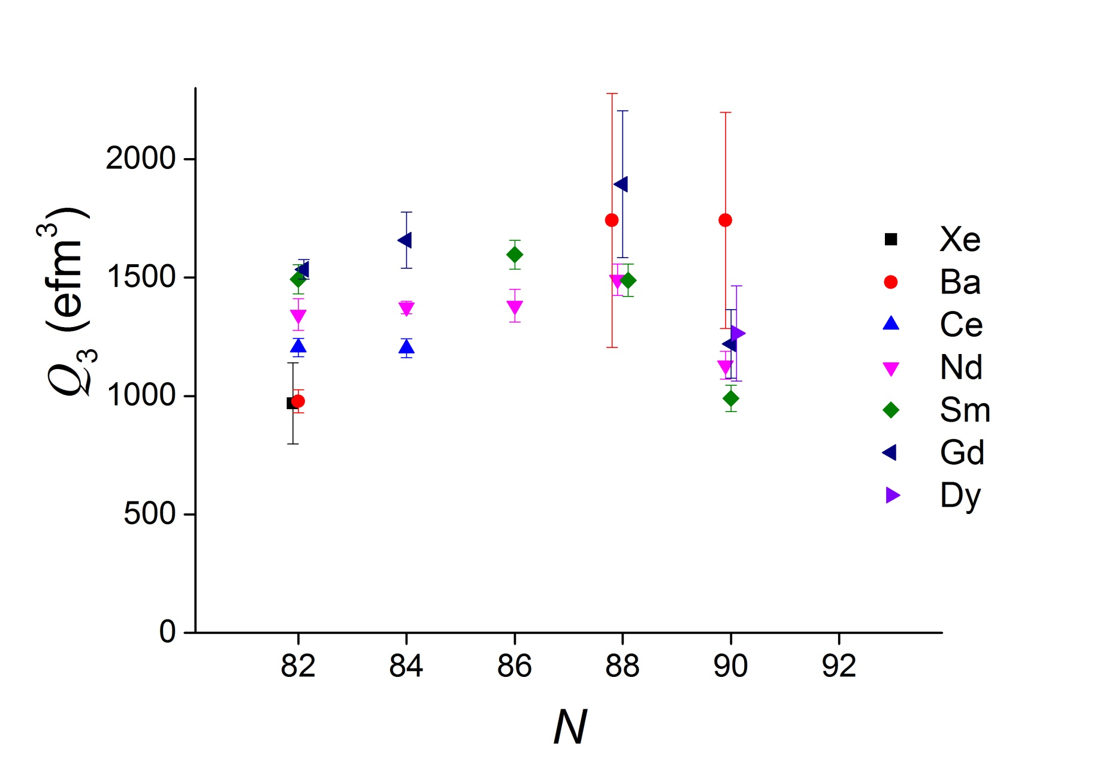
Motivation #2: B(E3)s in ^{144,146}Ba
B Bucher et al.
PRL 116, 112503 (2016)
B Bucher et al.
PRL 118, 152504 (2017)
¹⁴⁴Ba: 2⁺ 199, 4⁺ 530, 1⁻ 759, 3⁻ 838, 6⁺ 961
¹⁴⁶Ba: 2⁺ 181, 4⁺ 514, 1⁻ 738, 3⁻ 821, 6⁺ 958
separation > 79 keV

Slide 5
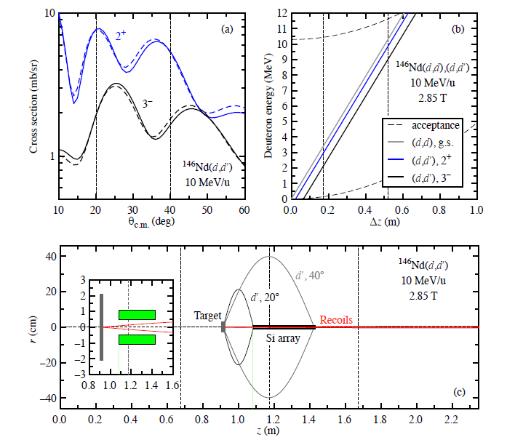
Experimental details
(taken from Ben Kay et al., ATLAS #1619)
Using Ptolemy
Q-value = 1.01 E_{lab} (MeV) - 0.20Δz (cm)
competing
channels:
CN
(d,t)
(d,³He)
(d,α)
5 days:
~10% error in B(E3)
(10⁵ ions/s
20 μg/cm²)
Similar to Coulex IS553

Slide 6
Q-value resolution
d(²⁴Ne,p)²⁵Ne @ 10 MeV/u
With HIE-ISOLDE beam: ~40 keV
With manipulated beam*: ~25 keV
Similar results obtained by M Labiche
*manipulated beam:
FWHM ΔE/E reduced from 0.5% to 0.1% through de-bunching and phase rotation
Transverse emittance (normalised rms) reduced from 0.1 to 0.02 mm mrad through collimation

